Slide 1
Trips Users Cyclistic
File created on: 7/21/2023 9:15:13 AM

Slide 2
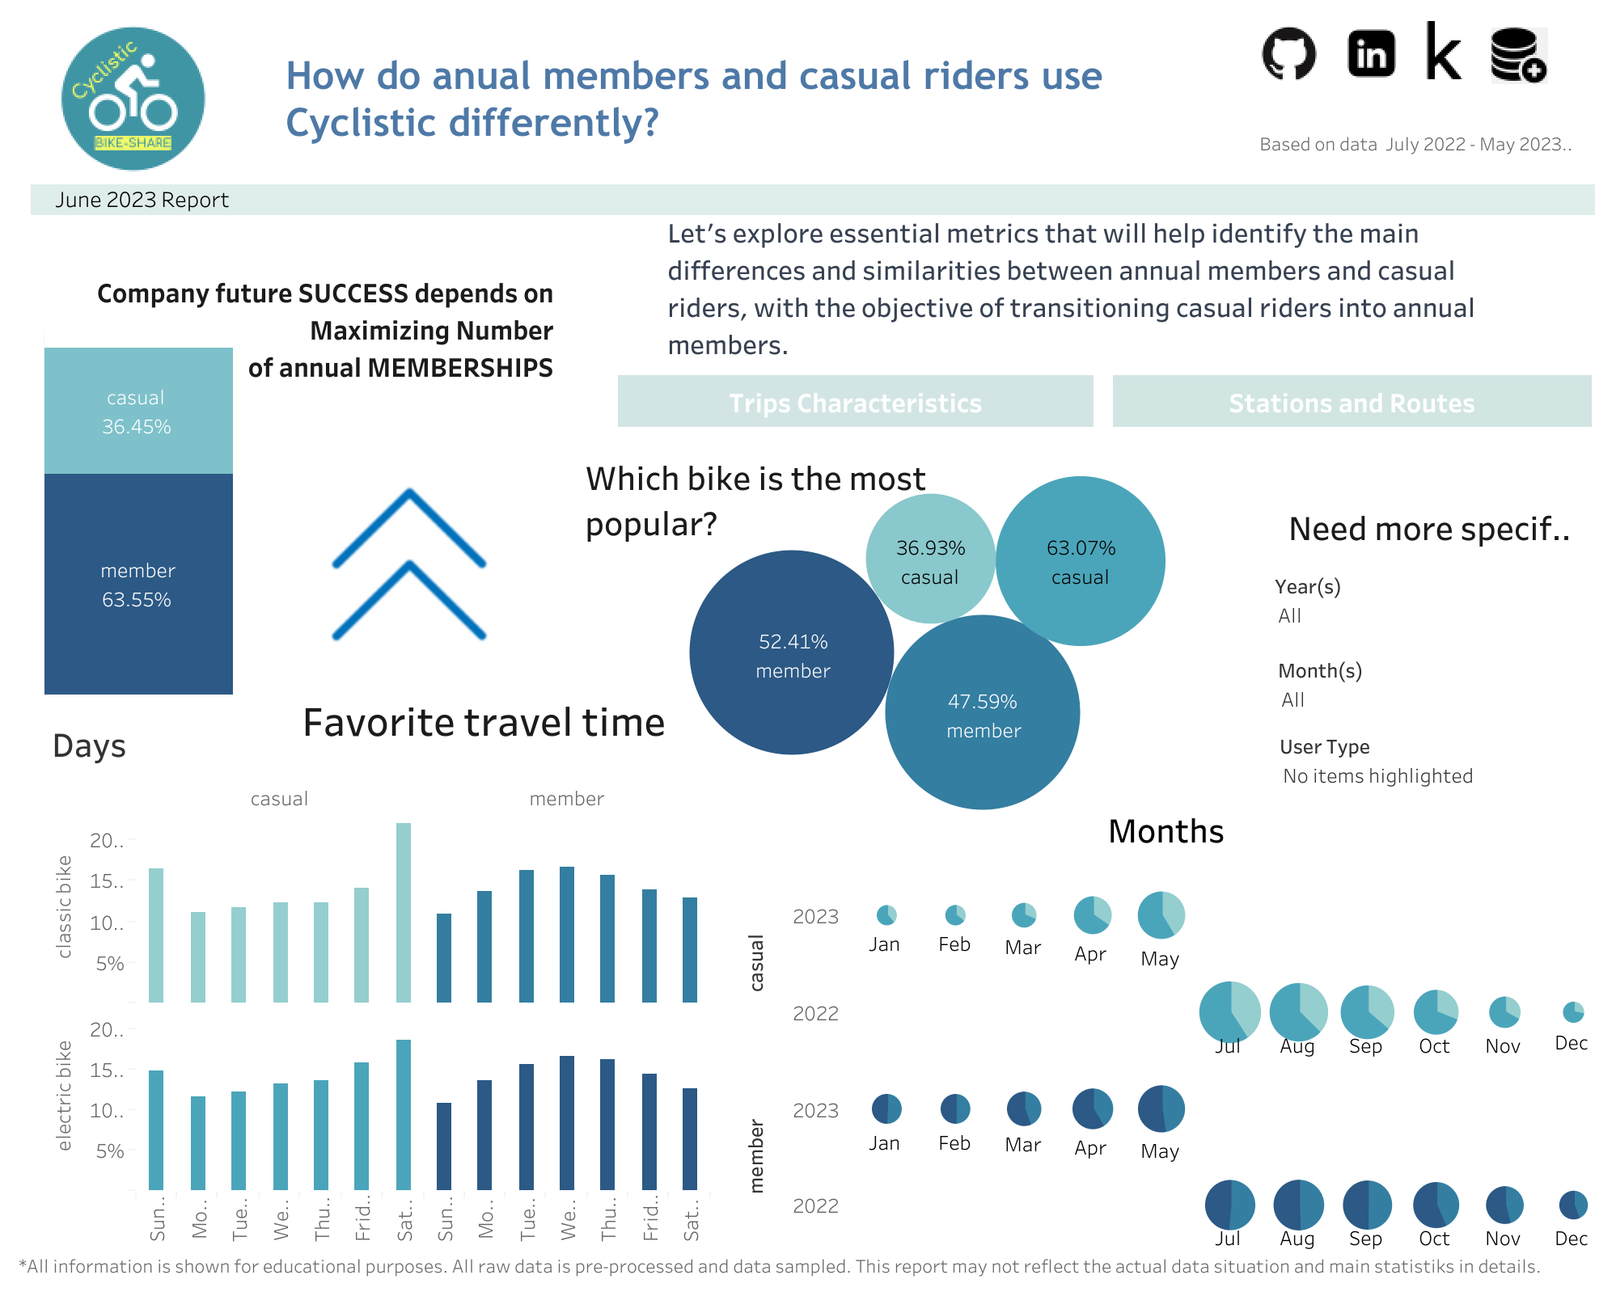

Slide 3
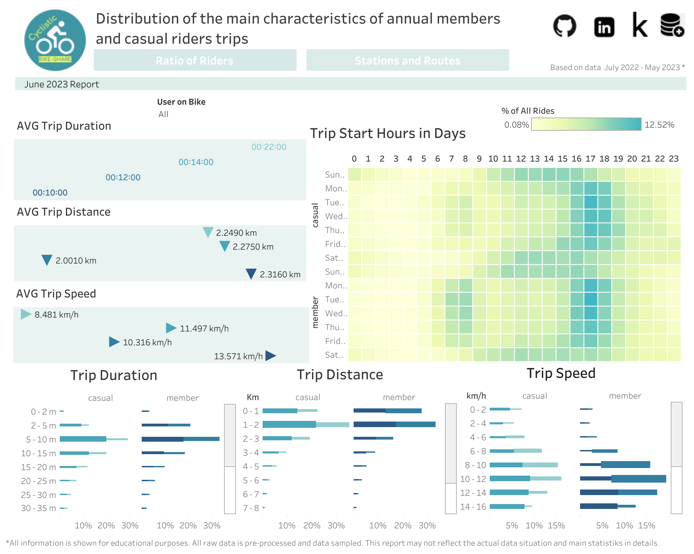

Slide 4
